Slide 1



Slide 2


Project: RIFT
Real-Time Identification of Fraudulent Transactions
Sayesha Aravapalli, Truett Bloxsom, Qingzi Zeng, Matthew Zlotnik
Faculty Advisors: Tejwansh S. Anand, Daniel Mitchell
Sponsors: Carolina Barcenas, Chiranjeet Chetia, Jianhua Huang

Slide 3
Agenda
01
02
03
Business Intent & Implementation
EDA & Feature Engineering
DBSCAN
04
05
06
K-means
Network Model
Conclusion & Next Steps

Slide 4
Problem Statement
Detecting collaborative frauds is difficult when transactions are processed individually
Determining which combinations of levels and nodes to freeze to maximize F1 score
Many instances of fraudulent transactions are elements of a larger cashout event
Using unsupervised learning methods will allow our models to be run in real-time rather than having to wait on official fraud labels
Notes:
During a normal day, thousands of transactions per second flow through the VISA network, some of which may be fraudulent. VISA can identify fraud at a transaction-level in real time, but identifying large-scale interconnected fraud can be an entirely different challenge.
****VERY IMPORTNANT TO DETECT COMBINATION OF LEVELS ****

Slide 5
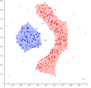
Implementation: Clustering
Preprocessing Steps
Clustering Analysis
Profiling System
Labelled cashout events
Transaction-level fraud prediction
Continuous numerical predictors from date/time data
Issuer Bin | Pan | Countries | Cities | Acquirer Bin | Merchants | Fraud Pattern
1 | 1 | 2 | 10 | 5 | 8 | Account take-over
1 | 10 | 1 | 1 | 20 | 7 | Issuer Bin attacked in a city
3 | 10 | 1 | 3 | 1 | 5 | Acquirer Bin attacked
5 | 10 | 2 | 20 | 4 | 1 | Merchant attacked
Notes:
****MAKE MODELS MORE INDEPENDENT ****
*** USE BULLENT POINTS BUT KEEP PICTURES***

Slide 6

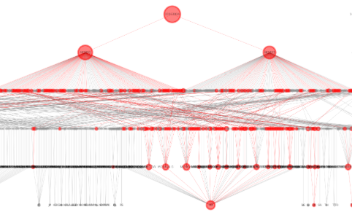
Implementation: NetworkX
Preprocessing Steps
Network Analysis
Visual Alerting System
Labelled cashout events
Transaction-level fraud prediction
Create baseline network statistics for each node
Notes:
****MAKE MODELS MORE INDEPENDENT ****
*** USE BULLENT POINTS BUT KEEP PICTURES***

Slide 7
Business Value
Major Revenue Streams :
Number of transactions
Amount of each transaction
RIFT Added Value:
Decreasing losses
Increasing Customer trust

Slide 8
Agenda
01
02
03
Business Intent & Implementation
EDA & Feature Engineering
DBSCAN
04
05
06
K-means
Network Model
Conclusion & Next Steps

Slide 9
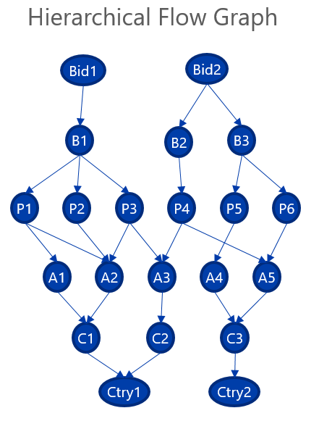
Structure of Data
Transaction Type:
Cross border transactions
Period:
April 2018 – April 2019
Size:
~47M transactions
256K transactions/ day
Features:
19 categorical: BID, BIN, PAN, ATM, CITY…
3 numerical: transaction amount, predicted probability…
5 datetime
Classes:
0.55% fraud, 0.07% cashout
BID: unique identifier of a bank
BIN: initial 4-6 digits on credit cards
PAN: individual account
ATM
CITY
COUNTRY

Slide 10
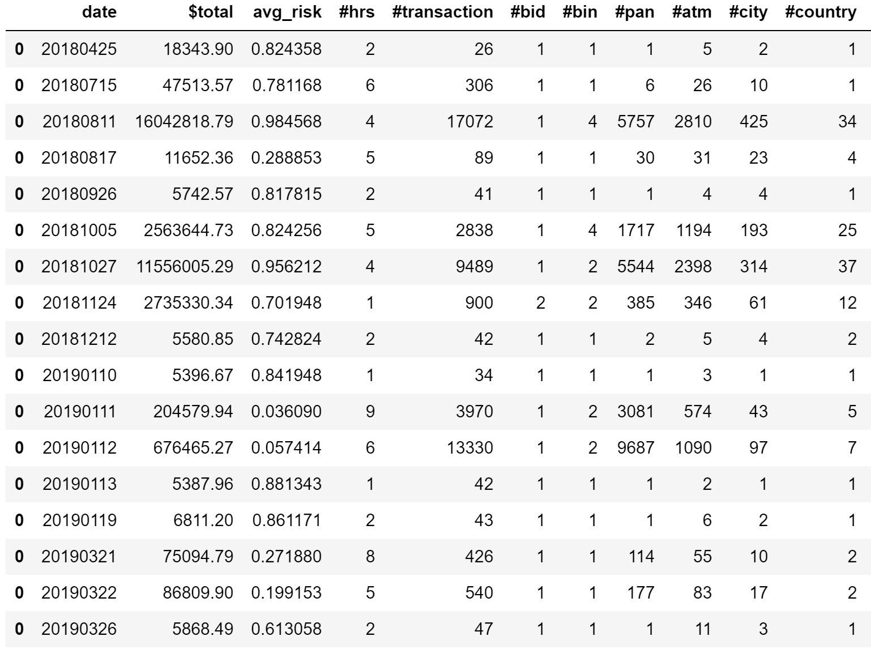
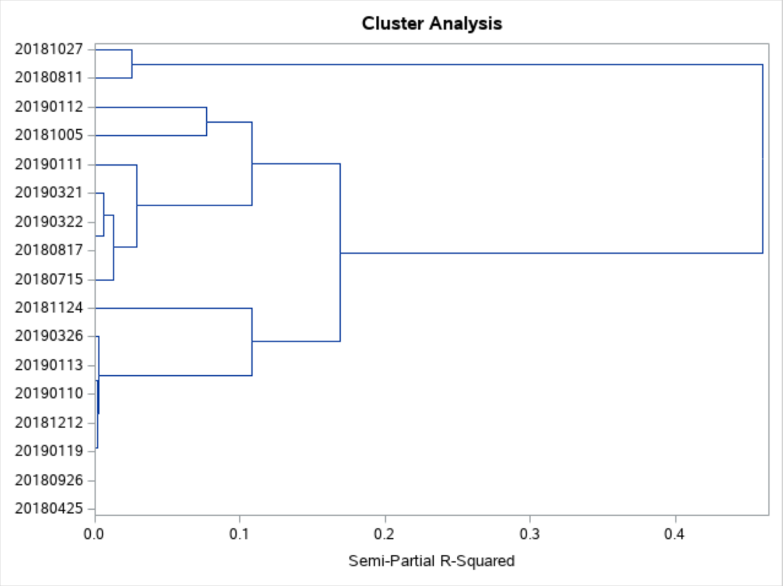
Cashout Events: All

Slide 11
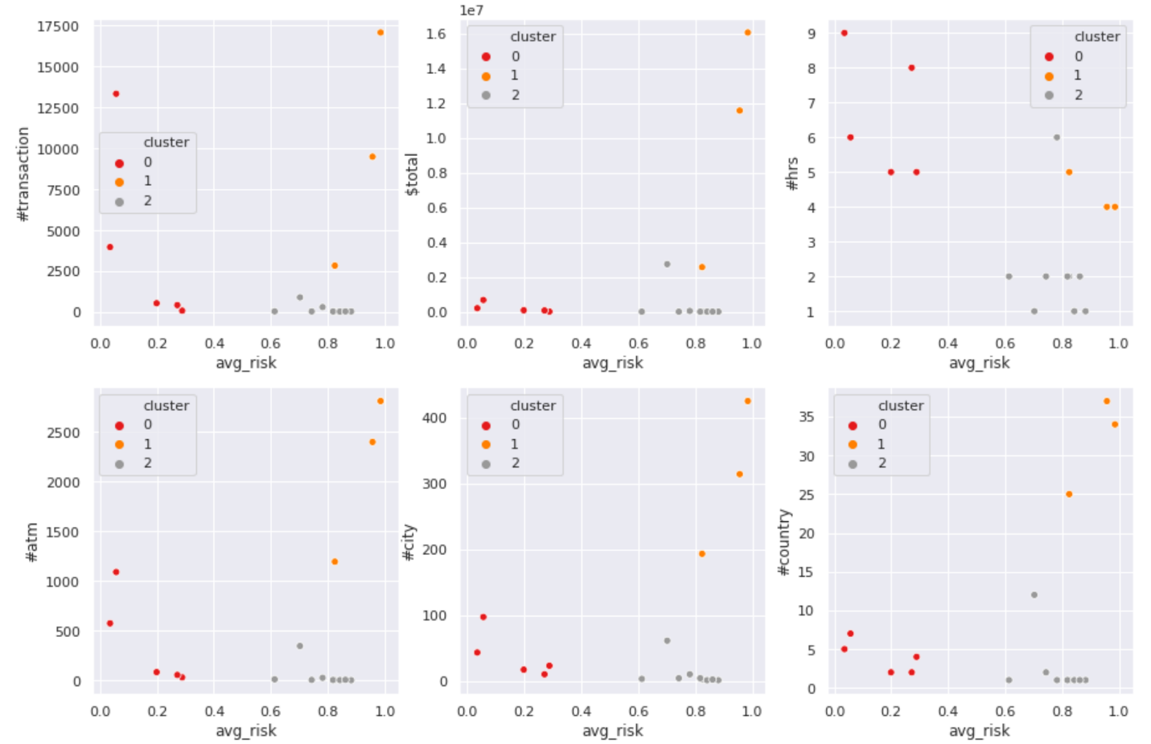
Cashout Events: All
3 types of cashouts:
 | Camouflaged Cashouts | Disastrous Cashouts | Small Cashouts
Loss | Moderate | Huge | Small
Risk | Low <0.3 | High >0.8 | High >0.6
Duration | 5-9h | 4-5h | 1-2h
Countries | 2~10 | 20+ | 1~2
Cities | <100 | 200+ | <50
ATMs | <1100 | >1100 | <500

Slide 12

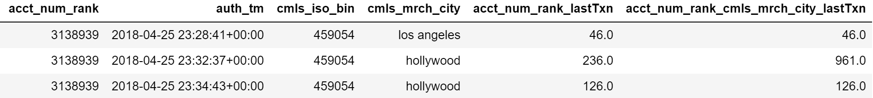
Feature Engineering
Time features: time interval between current and last transaction
PAN
PAN
CITY

Slide 13
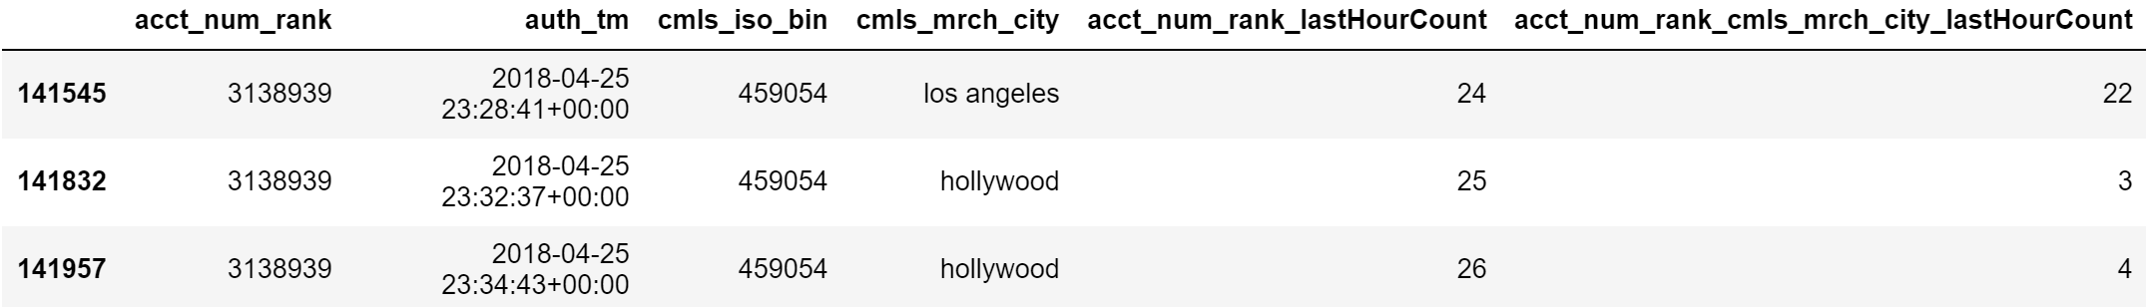
Feature Engineering
Count features: number of transactions in the previous hour
PAN
PAN
CITY

Slide 14
Agenda
01
02
03
Business Intent & Implementation
EDA & Feature Engineering
DBSCAN
04
05
06
K-means
Network Model
Conclusion & Next Steps

Slide 15
DBSCAN: Train Data
Advantages
Does not require one to specify the number of clusters
It is robust to outliers
It can find arbitrarily shaped clusters
As cashout transactions are very similar to each other we
expect them to form clusters, and most normal transactions
being pretty different would be classified as noise
Equal weighted model :
​Only Count features used
Metric to choose best model : Gini index ​
Final model :​
​
Fradulent transactions | 15.18%
Camouflaged cashouts | 4.76%
Disastrous cashouts | 4.76%
Small cashouts | 4.76%
Total transactions | 4041
Epsilon | Minpoints
0.9 | 50
Notes:
Dbscan intro adv. Dis.

Slide 16
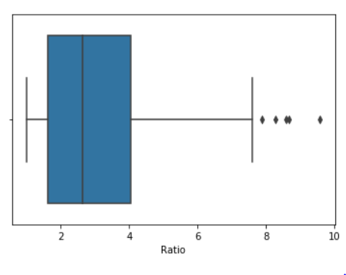
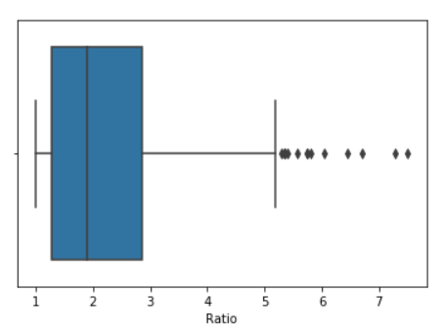
Steps
Cluster the 1 hour data using the model parameters
Identify cashout clusters based on the threshold
Profile the cashout clusters and look for bins/bids
For the transactions related to specific bins and bids, block the countries
Finding thresholds
Bid Ratio = #data points in cluster
------------------------------------
#unique bids in cluster
Bin Ratio = #data points in cluster
------------------------------------
#unique bins in cluster
Bid
Bin
Max value : 7.5
Max value : 9.57
BID ratio
Bid ratio < 7.5 - Mostly normal transactions
8 < Bid ratio < 20 - Both normal and cashout transactions
Bid ratio > 20 - Mostly cashout transactions with few bins
BIN ratio
Bin ratio < 10 - Mostly normal transactions
10 < Bin ratio < 30 - Both normal and cashout transactions
Bin ratio > 30 - Mostly cashout transactions with few bins

Slide 17
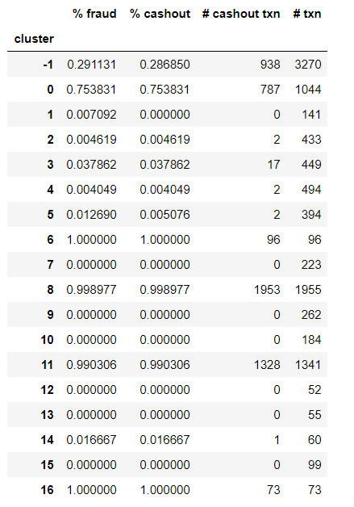
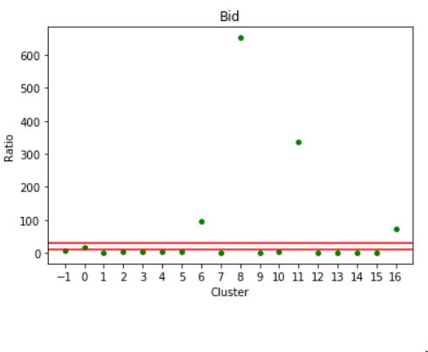
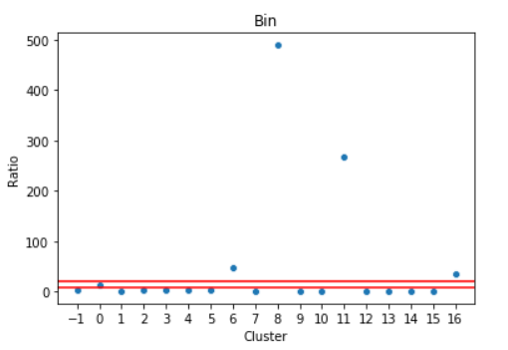
DBSCAN : Test data (Disastrous)
Test: 10/27/2018 , 136052 transactions , 9489 cashout
Hour | Number of Cashout transactions
8:00-9:00 | 106
9:00-10:00 | 5199
10:00-11:00 | 4144
11:00-12:00 | 40
Hour 9:00 –10:00
Cashout clusters :
Clusters 6,8,11,16
Notes:
Cluster 3 : It is a bin attack in a country.
cmls_iso_bin_ct_mrch_ctry_lastTxn and bid_ct_mrch_ctry_lastTxn have very low time to last transaction
Cluster 4 : It is a bin attack in a city
Cmls_iso_bin_cmls_mrch_city_lastTxn ; bid_cmls_mrch_city_lastTxn ; cmls_iso_bin_ct_mrch_ctry_lastTxn and bid_ct_mrch_ctry_lastTxn have very low time to last transaction
Cluster 5 : bid attack in a country.
bid_ct_mrch_ctry_lastTxn has very low time to last transaction
Cluster 6 : bid attack in a country.
ct_mrch_ctry_lastTxn and bid_lastTxn has very low time to last transaction.
bid_ct_mrch_ctry_lastTxn has very low time to last transaction
Cluster 4 : Possible bin attack in a country.
Cluster 5 : Possible bin attack in a city
Cluster 6 : Possible bid attack in a country.
Cluster 7 : Possible bid attack in a country.

Slide 18
Recommendations
Characterizing cluster 8
Cluster | Bid | Count | Percentage | Cluster Size
8 | 10063934 | 1953 | 99.98% | 1955
Cluster | Bin | Count | Percentage | Cluster Size
8 | 462882 | 1053 | 53.86% | 1955
8 | 462883 | 900 | 46.03% | 1955
​
Net Monetary Loss : $ 300,000 ​
Gain (TP) : $ 5.57 M​
False Alarm (FP) : $10,404​
Loss (FN) : $ 5.98 M​
​
Block bins
462882 and 462883 of bid 10063934​
in
All countries
From hour 10:00
Countries - RU,CZ,GB,AE,IT,SK,FI,TR,PL,SI,GE,UA,KH,CA,DO,DE,US,NL,LV,LT,IL,AU,BE,GR,ES,NP,MX,SG,FR,EE
Notes:
Future Scope
For a real time application, 1 hour data can be used to cluster and cluster characteristics can be studied to identify fraudulent events
Can try identify fradulent/non-fraudulent clusters using cluster characteristics rather than labels so that it can be used for real time transactions

Slide 19
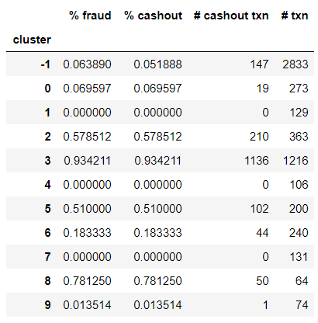
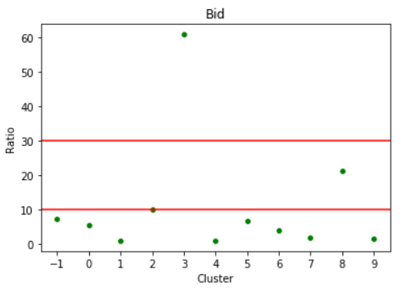
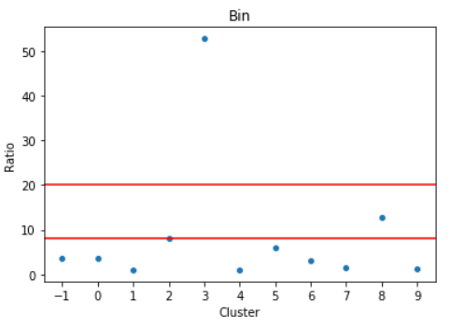
DBSCAN : Test data (camouflaged)
Test: 01/12/2019 , 121466 transactions , 13330 cashout
Hour | Number of Cashout transactions
0:00-1:00 | 1709
1:00-2:00 | 1937
2:00-3:00 | 2872
3:00-4:00 | 3744
Hour 0:00 –1:00
Cashout clusters :
Clusters 3,8
Notes:
Cluster 3 : It is a bin attack in a country.
cmls_iso_bin_ct_mrch_ctry_lastTxn and bid_ct_mrch_ctry_lastTxn have very low time to last transaction
Cluster 4 : It is a bin attack in a city
Cmls_iso_bin_cmls_mrch_city_lastTxn ; bid_cmls_mrch_city_lastTxn ; cmls_iso_bin_ct_mrch_ctry_lastTxn and bid_ct_mrch_ctry_lastTxn have very low time to last transaction
Cluster 5 : bid attack in a country.
bid_ct_mrch_ctry_lastTxn has very low time to last transaction
Cluster 6 : bid attack in a country.
ct_mrch_ctry_lastTxn and bid_lastTxn has very low time to last transaction.
bid_ct_mrch_ctry_lastTxn has very low time to last transaction
Cluster 4 : Possible bin attack in a country.
Cluster 5 : Possible bin attack in a city
Cluster 6 : Possible bid attack in a country.
Cluster 7 : Possible bid attack in a country.

Slide 20
Recommendations
Characterizing cluster 3
Cluster | Bid | Count | Percentage | Cluster Size
3 | 10017234 | 1136 | 93.42% | 1216
3 | 10067766 | 19 | 1.56% | 1216
Cluster | Bin | Count | Percentage | Cluster Size
3 | 426448 | 704 | 57.89% | 1216
3 | 415222 | 432 | 35.52% | 1216
Block
Bins – 462448 and 415222
Bid – 10017234
Countries - BR, BG, AR, HN
From hour 1:00
​
Net Monetary Gain : ~$ 336,000 ​
Gain (TP) : $ 581,427 ​
False Alarm (FP) : $23,693
Loss (FN) : $ 221,551
​
Notes:
Future Scope
For a real time application, 1 hour data can be used to cluster and cluster characteristics can be studied to identify fraudulent events
Can try identify fradulent/non-fraudulent clusters using cluster characteristics rather than labels so that it can be used for real time transactions

Slide 21
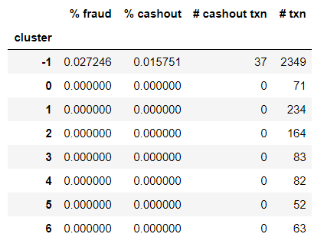
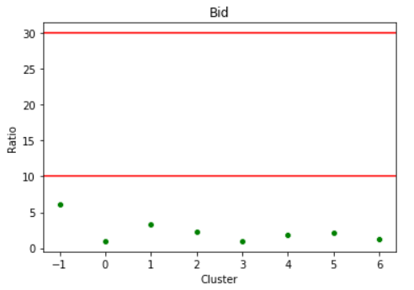
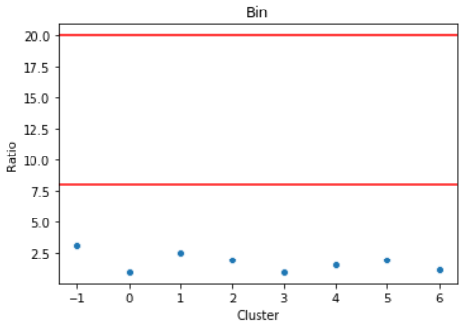
DBSCAN : Test data (small cashout)
Test: 03/26/2019 , 98639 transactions , 47 cashout
Hour | Number of Cashout transactions
3:00-4:00 | 0
4:00-5:00 | 37
5:00-6:00 | 10
6:00-7:00 | 0
Hour 4:00 –5:00
Cashout clusters :
None
Notes:
Cluster 3 : It is a bin attack in a country.
cmls_iso_bin_ct_mrch_ctry_lastTxn and bid_ct_mrch_ctry_lastTxn have very low time to last transaction
Cluster 4 : It is a bin attack in a city
Cmls_iso_bin_cmls_mrch_city_lastTxn ; bid_cmls_mrch_city_lastTxn ; cmls_iso_bin_ct_mrch_ctry_lastTxn and bid_ct_mrch_ctry_lastTxn have very low time to last transaction
Cluster 5 : bid attack in a country.
bid_ct_mrch_ctry_lastTxn has very low time to last transaction
Cluster 6 : bid attack in a country.
ct_mrch_ctry_lastTxn and bid_lastTxn has very low time to last transaction.
bid_ct_mrch_ctry_lastTxn has very low time to last transaction
Cluster 4 : Possible bin attack in a country.
Cluster 5 : Possible bin attack in a city
Cluster 6 : Possible bid attack in a country.
Cluster 7 : Possible bid attack in a country.

Slide 22
Agenda
01
02
03
Business Intent & Implementation
EDA & Feature Engineering
DBSCAN
04
05
06
K-means
Network Model
Conclusion & Next Steps

Slide 23
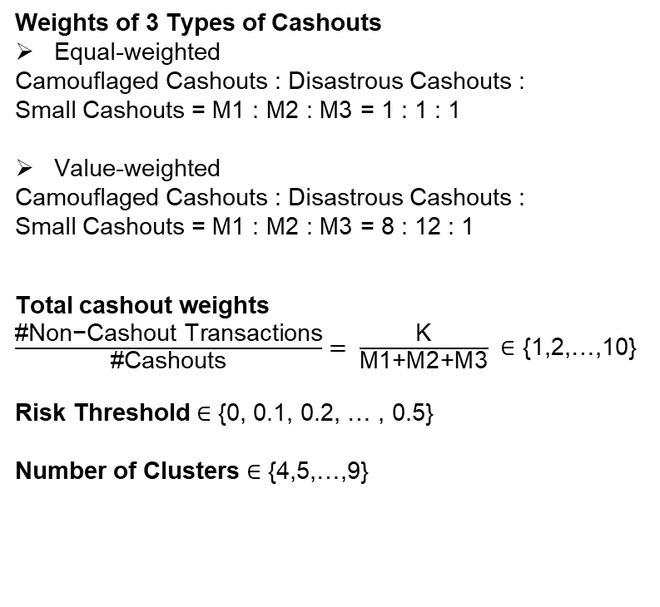
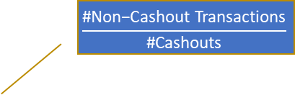
K-Means Clustering: Model Selection
All Transactions: N
Weights of 3 Types of Cashouts
Equal-weighted
Camouflaged Cashouts : Disastrous Cashouts : Small Cashouts = M1 : M2 : M3 = 1 : 1 : 1
Value-weighted
Camouflaged Cashouts : Disastrous Cashouts : Small Cashouts = M1 : M2 : M3 = 8 : 12 : 1
Total cashout weights
$\frac{\text{\#}\text{Non}\text{−}\text{Cashout} \text{Transactions}}{\text{\#}\text{Cashouts}}= \frac{\text{K}}{\text{M}\text{1+}\text{M}\text{2+}\text{M}\text{3}} ∈$ {1,2,…,10}
Risk Threshold ∈ {0, 0.1, 0.2, … , 0.5}
Number of Clusters ∈ {4,5,…,9}
Equal-weighted or Value-weighted
Cashouts: M
Non-Cashouts: K
Camouflage:M1
Disastrous: M2
Small: M3
$$\frac{\text{\#}\text{Non}\text{−}\text{Cashout} \text{Transactions}}{\text{\#}\text{Cashouts}}$$
Training Data
Risk Threshold
Model Input
K-Means: Number of Clusters
Model Output

Slide 24
K-Means Clustering: Best Model
Equal weighted model :
Fradulent transactions | 15.18%
Camouflaged cashouts | 4.76%
Disastrous cashouts | 4.76%
Small cashouts | 4.76%
Total transactions | 9429
Cluster | % Fraud | % Cashout | # Transactions
0 | 4.75% | 4.52% | 2147
1 | 1.28% | 0.87% | 2978
2 | 0.00% | 0.00% | 14
3 | 81.23% | 74.73% | 554
4 | 1.31% | 0.44% | 916
5 | 89.40% | 89.24% | 604
6 | 14.88% | 13.82% | 1889
7 | 0.00% | 0.00% | 115
8 | 3.77% | 2.83% | 212
Metric to choose best model : Gini index ​
Final model :​
Risk Threshold | # Cluster | Gini
0.0 | 9.0 | 0.1094

Slide 25
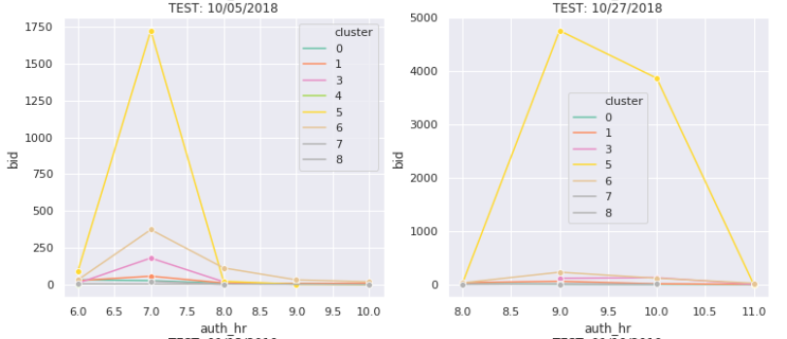
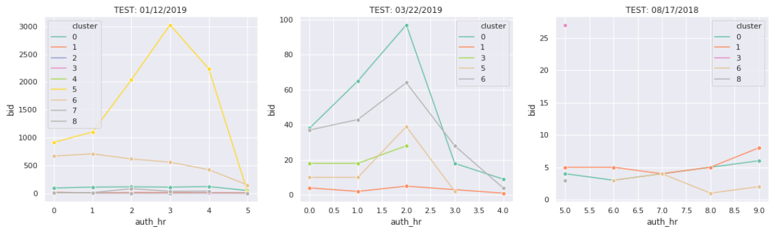
K-Means Clustering: Test
Cashout Clusters: 3, 5 & 6
Disastrous Cashouts
10/05/2018, 10/27/2018: Cluster 5
Camouflaged Cashouts
01/12/2019: Cluster 5, 6
03/22/2019: Cluster 0, 6, 3, 5
08/17/2018: Cluster 3

Slide 26
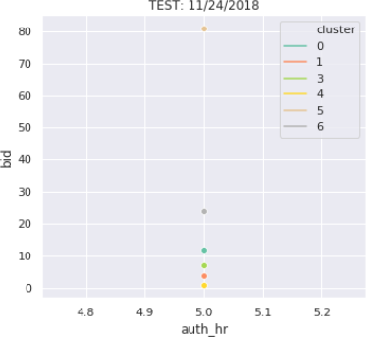
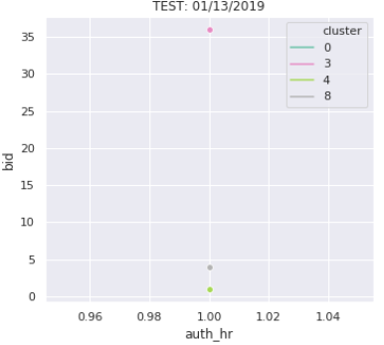
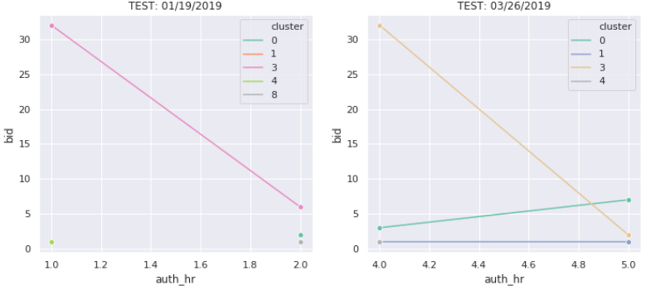
K-Means Clustering: Test
Cashout Clusters: 3, 5 & 6
Small Cashouts
11/24/2018: Cluster 5
01/13/2019, 01/19/2019, 03/26/2019: Cluster 3

Slide 27
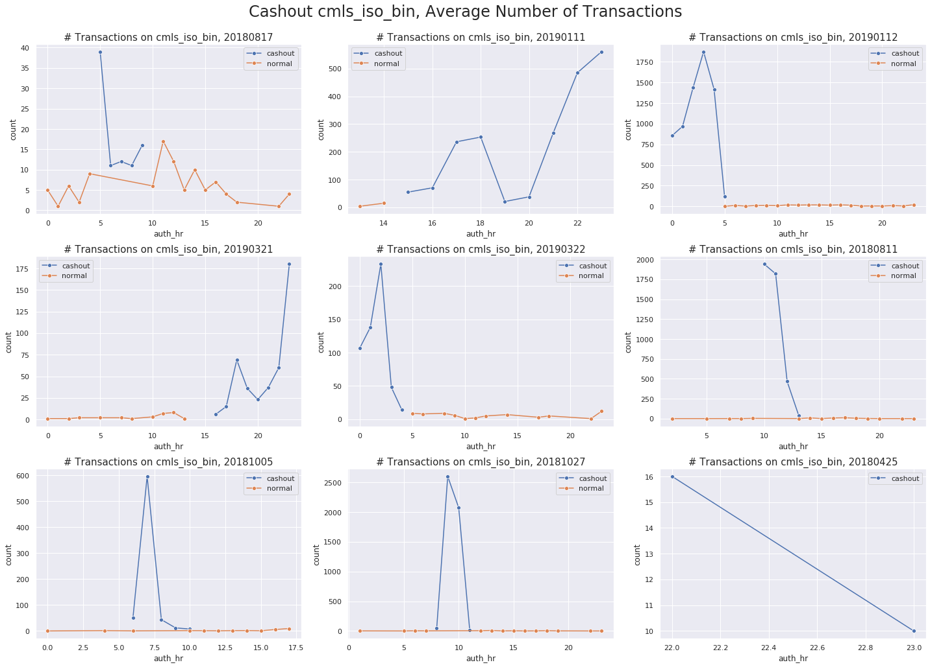
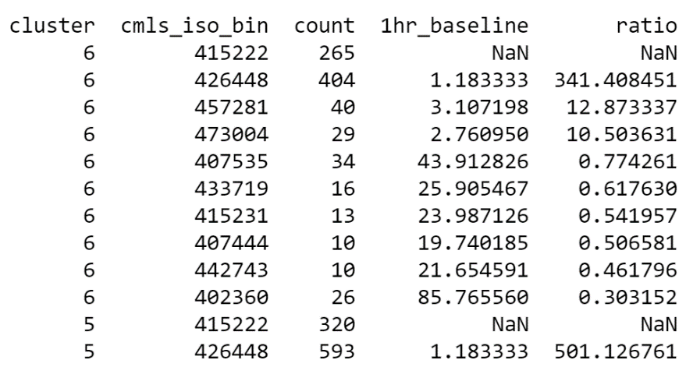
K-Means Clustering: Cashout Clusters
01/12/2019
0:00-1:00
Ratio = count/1hr_baseline
Cashout BINs:
415222,426448

Slide 28
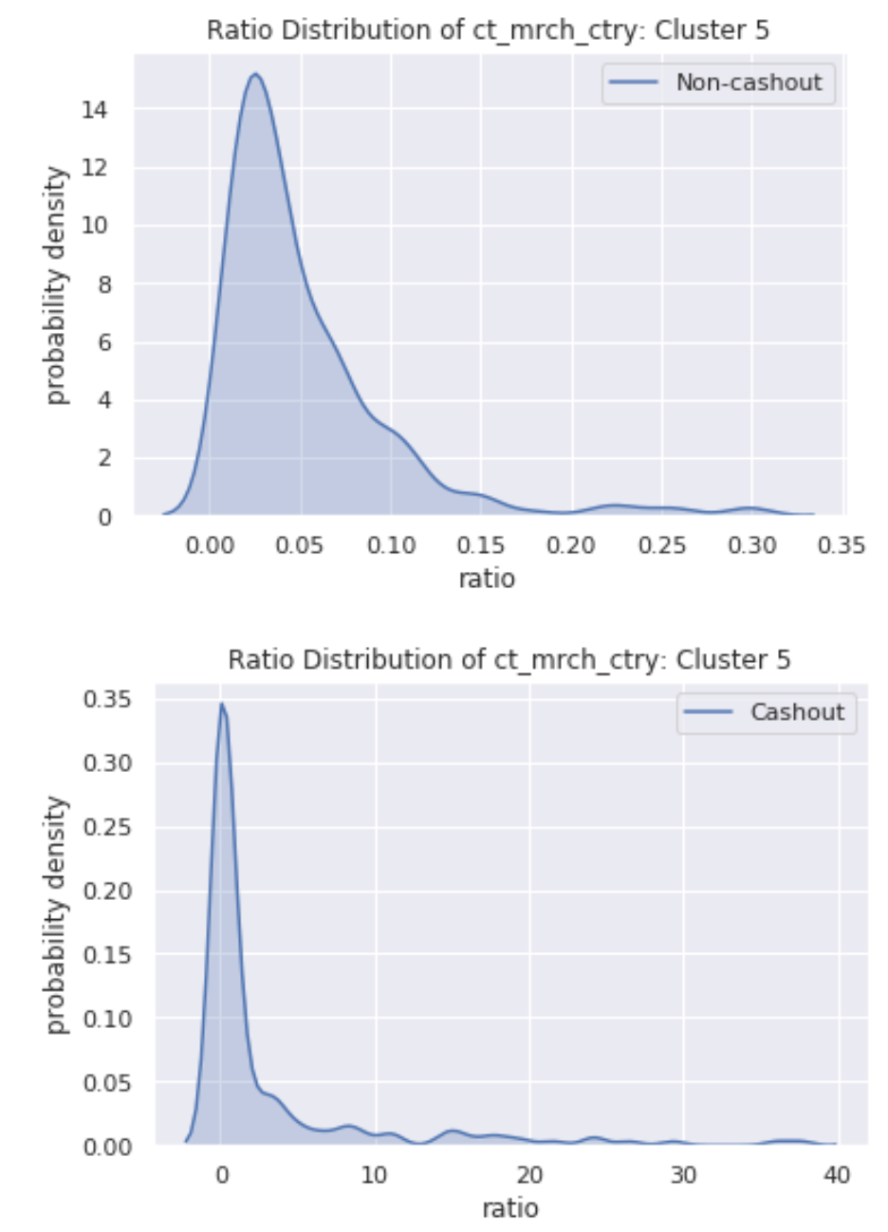
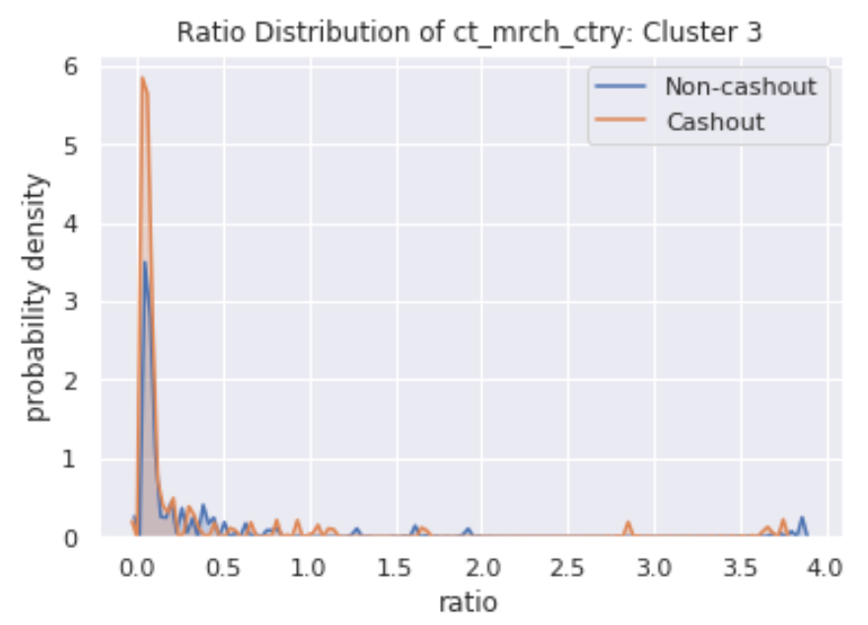
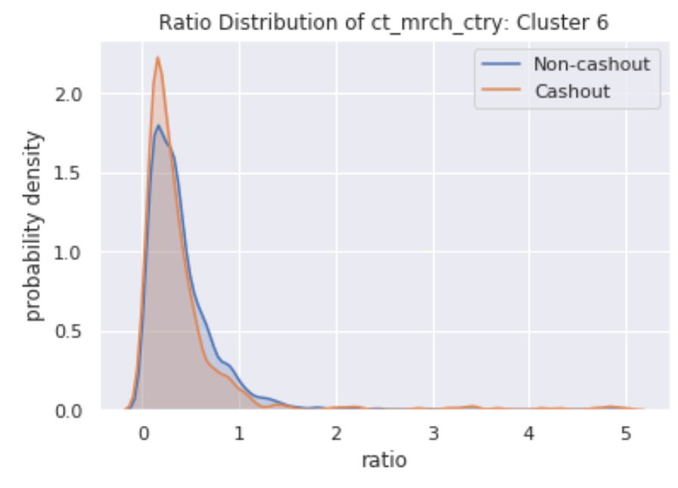
K-Means Clustering:
Choosing Threshold
Test range:
 | Cluster 3 | Cluster 5 | Cluster 6
BIN | {3,5,10,20} | {3,4,6,8} | {5,7,10,20}
CITY | {} | {1,2} | {}
COUNTRY | {} | {0.1,0.2} | {}

Slide 29
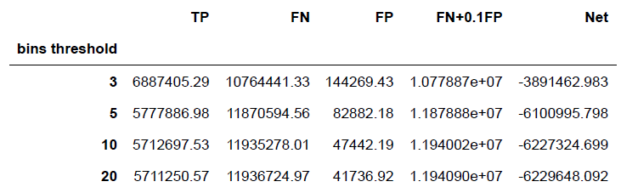
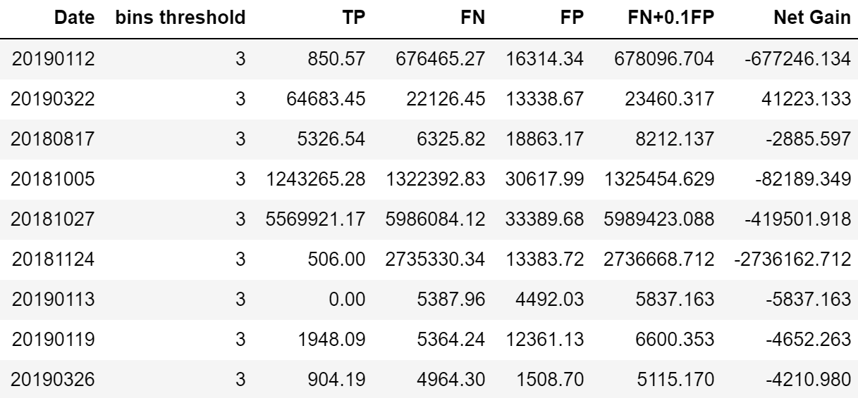
Cluster 3
K-Means Clustering: Block BINs
Optimal ratio threshold is 3
Net loss of 3.89M at optimal threshold
Cluster 3 can capture all types of cashouts, while its performance on capturing camouflaged and disastrous cashouts is worse than cluster 5 & 6
Cluster 3 is unique in that it can capture small cashouts, but the TP is still low, mainly because time lag in taking actions
Net Gain(Loss) = TP - FN - 0.1FP

Slide 30
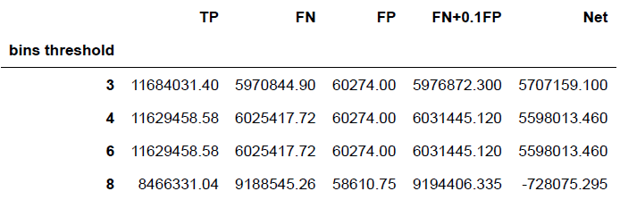
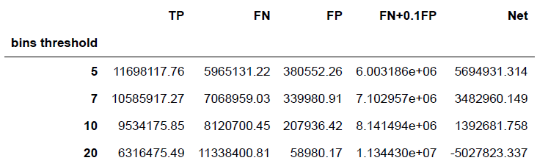
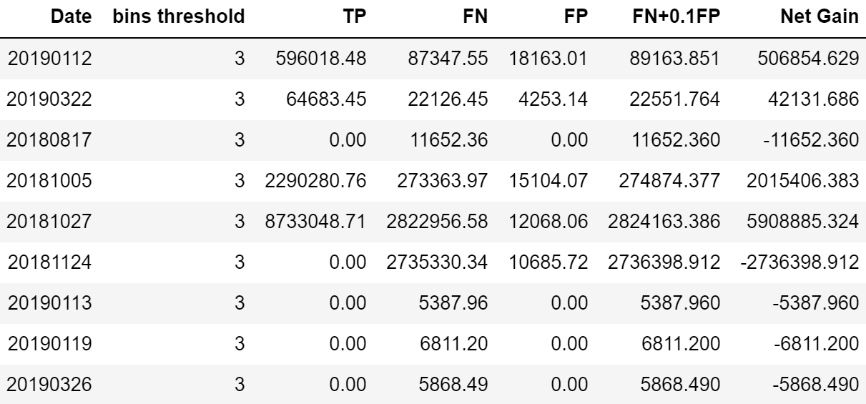
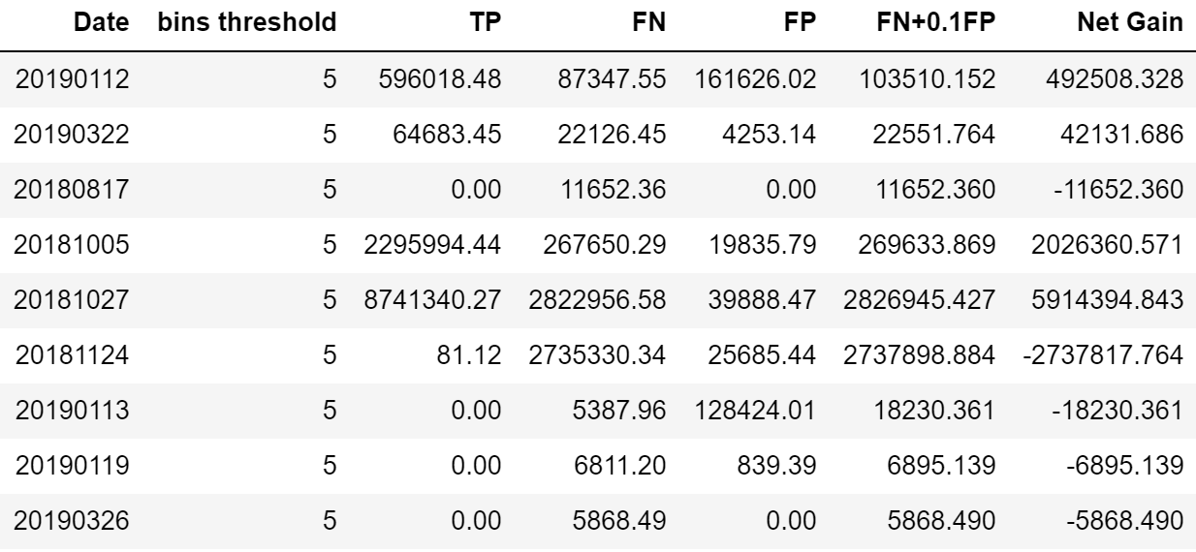
Cluster 5
Cluster 6
Indicates cashout events captured by cluster 3
Optimal BIN threshold is 3 for cluster 5, 5 for cluster 6
Cluster 5 & 6 are similar: they capture same cashout events
Cluster 5 performs better than 6: FP is lower

Slide 31
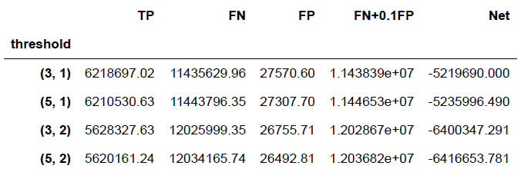
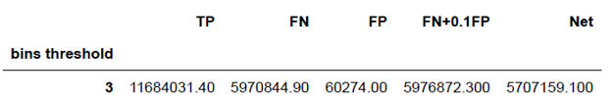
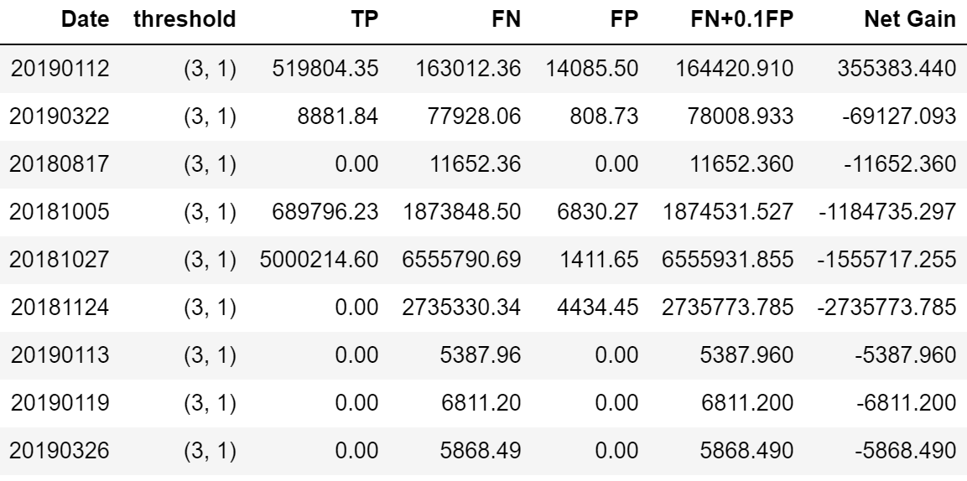
Block BINs in Cities in Cluster 5
K-Means Clustering: Block BINs in Cities
Block BINs in Cluster 5
Optimal threshold is 3 for BINs and 1 for cities in cluster 5
Block BINs in cities results in decrease in FP, but also decrease in TP
Net Gain(Loss) = TP - FN - 0.1FP

Slide 32
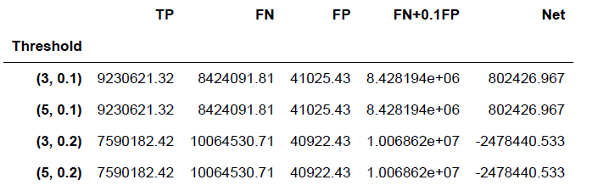
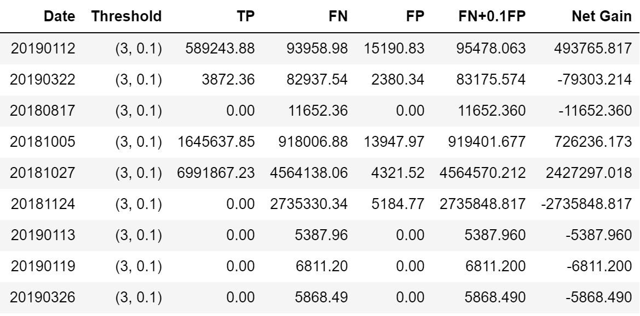
Block BINs in Countries in Cluster 5
K-Means Clustering: Block BINs in Countries
Block BINs in Cluster 5
Optimal threshold is 3 for BINs and 0.1 for countries in cluster 5
Block BINs in countries results in decrease in FP, but also decrease in TP
Net Gain(Loss) = TP - FN - 0.1FP

Slide 33
K-Means Clustering: Why Blocking BINs Works Best?
Cluster 5 is a pure cashout cluster with 90% cashout transactions. The ratio of normal bins in this cluster is low, hence normal bins are less likely to be blocked -> low FP
Inactive BINs are used in cashout events. Block the inactive BINs won’t influence many normal transactions -> low FP
Popular countries and cities are difficult to detect using ratio method -> reduces TP
Syntax problem in city name: MOSKVA G, MOSCOW, MOSKVA, Moscow…. -> reduces TP

Slide 34
K-Means Clustering: Conclusion
Optimal ratio threshold:
 | Cluster 3 | Cluster 5 | Cluster 6
BIN | 3 | 3 | 5
CITY | - | 1 | -
COUNTRY | - | 0.1 | -
Recommended action:
For large-scale cashouts: block BINs in cluster 5
For all cashouts: block BINs in cluster 3&5
Action | TP | TN | FP | Net Gain(Loss)
Block BINs in Cluster 3 | 6,887,405.29 | 10,764,441.33 | 144,269.43 | (3,891,462.983)
Block BINs in Cluster 5 | 11,684,031.40 | 5,970,844.90 | 60,274.00 | 5,707,159.100
Block BINs in Cluster 6 | 11,698,117.76 | 5,965,131.22 | 380,552.26 | 5,694,931.314
Block BINs in Cities in Cluster 5 | 6,218,697.02 | 11,435,629.96 | 27,570.60 | (5,219,690.000)
Block BINs in Countries in Cluster 5 | 9,230,621.32 | 8,424,091.81 | 41,025.43 | 802,426.967
Block BINs in Cluster 3&5 | 11,695,580.17 | 5,963,167.21 | 165,133.02 | 5,715,899.658
Business Outcome :
Net Monetary Gain : $ 5.71 M
Precision: 0.9689
recall: 0.7866
F1-score: 0.8683

Slide 35
Agenda
01
02
03
Business Intent & Implementation
EDA & Feature Engineering
DBSCAN
04
05
06
K-means
Network Model
Conclusion & Next Steps

Slide 36
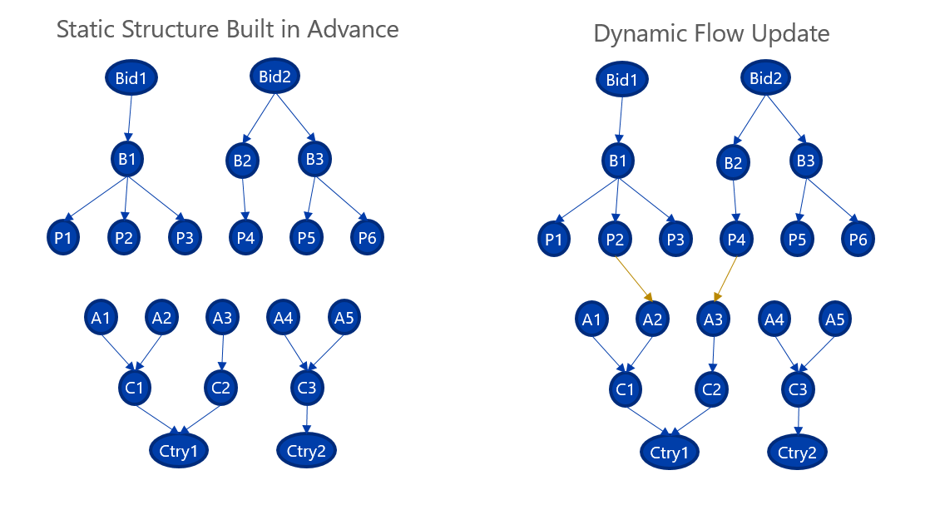
Network Model Structure and Update
BID: unique identifier of a bank
BIN: initial 4-6 digits on credit cards
PAN: individual account
ATM
CITY
COUNTRY
Notes:
Our model starts with developing a baseline or average such as transaction amount, average connections to other nodes etc. for each node so we can have a sense of what a normal day looks like for these nodes. Second, when a new transaction comes in, we calculate the same metrics for the nodes connected to the transaction on an hour basis. Third we calculate a risk score based on the calculated hour metrics and baseline metrics. Finally we set a threshold for each level in the network and if a node's risk score is above this threshold, we identify it as being used in a cashout event.
SHOW TOP AND LOWER GRAPG AND HOW THEY CONNECT

Slide 37
Network Model Overview
Develop baseline metrics such as average connections, transaction amount, and prediction scores for each node, representing entities at different levels of the hierarchical network
When a new transaction comes in, calculate node metrics
Calculate Risk Value for node using both the baseline and individual metrics
Based on a unique threshold for the Risk Value for each type of node, send out an alert to stakeholders to block at risk nodes
BID: unique identifier of a bank
BIN: initial 4-6 digits on credit cards
PAN: individual account
ATM
CITY
COUNTRY
Notes:
Our model starts with developing a baseline or average such as transaction amount, average connections to other nodes etc. for each node so we can have a sense of what a normal day looks like for these nodes. Second, when a new transaction comes in, we calculate the same metrics for the nodes connected to the transaction on an hour basis. Third we calculate a risk score based on the calculated hour metrics and baseline metrics. Finally we set a threshold for each level in the network and if a node's risk score is above this threshold, we identify it as being used in a cashout event.
SHOW TOP AND LOWER GRAPG AND HOW THEY CONNECT

Slide 38
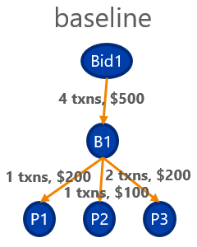
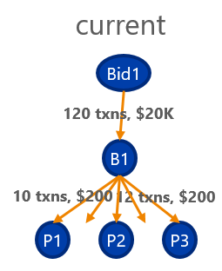
Network Model Example
Baseline is calculated over a month of transactions
Current network is refreshed each hour
Risk value is composed of a combination of variables in table
Each node level will have a different threshold
 | Node | Number of Transactions | Transaction Amount | Average Prediction Score | Number of Connections | Risk Value | Threshold
Baseline (Average) | Bid1 | 4 | 500 | .001 | 1 | NA | 50
Current | Bid1 | 120 | 20,000 | .25 | 1 | 88.3 | 50
Notes:
Since that was a lot to take in, lets go through a toy example. In this example we have calculated a baseline for a Bid or bank in the past. This is row 1 in the table. Today during an hour we then calculate those same metrics for this Bin which is in row 2 of the table. You can see that there are many more transactions and money flowing through this bid than on average. We then calculate a risk value based both on the current hour and baseline. That is why the baseline has no risk value. The risk value is above the threshold for bids so during this hour, this bid would be classified as risky and transactions using this bid would be blocked to stop fruad from occuring.

Slide 39
Network Model Formula
Risk Value = # of Trans * .3 Tran Amt * .1 Avg Pred * .3 # Connects * .3
BL # if Trans BL Tran Amt BL Avg Pred BL Connects
All metrics are normalized before Risk Value is calculated
BIDs, BINs, and Countrys < 1% missing baselines, Cities < 5% missing
ATMs and PANs do not have baselines
Risk Value can be viewed as a ratio score
 | Node | Number of Transactions | Transaction Amount | Average Prediction Score | Number of Connections | Risk Value | Threshold
Baseline (Average) | Bid1 | 4 | 500 | .001 | 1 | NA | 50
Current | Bid1 | 120 | 20,000 | .25 | 1 | 88.3 | 50

Slide 40
Network Model Training and Validation
For training the model (thresholds) used 2 hours of a camouflaged cashout event
Used a grid search like method with wide range of thresholds using F1 score to tune the thresholds without using cross validation
Once best train thresholds were found, used a 4 hour camouflaged cashout event for validation with thresholds slightly higher than best thresholds
Best thresholds for validation event were slightly lower than best train thresholds
Tweaked thresholds to be in-between best thresholds for train and validation sets

Slide 41
Network Model Results (camouflaged)
Level | F1 | Recall | Prec. | Threshold
Bid | 0.989 | 0.978 | 0.999 | 40
Bin | 0.974 | 0.996 | 0.952 | 10
Act | 0 | 0 | 0.001 | 4.5
ATM | 0.578 | 0.602 | 0.557 | 2.6
City | 0.692 | 0.958 | 0.542 | 1.8
Country | 0.822 | 0.949 | 0.724 | 2.0
Test results on camouflaged event show that identifying cashout at the BID, BIN, City, and Country levels is highly successful
During the cashout event, if the risky BINs in risky Countries were blocked from being used it would save the VISA clients ~860 thousand dollars with few non-fraud transactions being blocked
This is a 15% increase in savings over using just the supervised model
Using the model also reduces the false positives by ~575 thousand dollars
Notes:
We trained and validated the thresholds using separate cashout events. Then We tested our model using a cashout event that the model had never seen before over 13 hours and 2 days and these are the results. F1 score is a mean of recall and precison and it is the sore we used for accuracy. Recall is the fraction of total cashout tranasactions that were actually predicted correctly. Precision is the fraction of total non-cashout that we classified correctly. We obtain very high accuracy at the Bid and Bin level, with decent accuracy at the country and city level, and little accuracy at the ATM and account level. If we had just blocked the risky Bins using our model during this event, we would have saved VISA 5.6 million dollars. We also tested our model on a wide variety of cashout events and found similar results. The image above is a example visualization of the cashout event and the risky nodes are in red.

Slide 42
Network Model Results (disastrous)
Level | F1 | Recall | Prec. | Threshold
Bid | 0.999 | 0.999 | 0.999 | 40
Bin | 0.979 | 0.959 | 0.999 | 10
Act | 0.175 | 0.125 | 0.293 | 4.5
ATM | 0.303 | 0.925 | 0.181 | 2.6
City | 0.230 | 0.977 | 0.130 | 1.8
Country | 0.498 | 0.691 | 0.390 | 2.0
Identifying cashout at the BID, BIN, and country level is highly successful
If the risky BINs in risky countries were blocked from being used it would save the VISA clients ~140 thousand dollars with few non-fraud transactions being blocked
This is a 1% increase in savings over the supervised model
Using the model also reduces the false positives by ~330 thousand dollars
Supervised Model has high recall but low precision

Slide 43
Network Model Results (small)
Level | F1 | Recall | Prec. | Threshold
Bid | 0 | 0 | 0 | 40
Bin | 0.986 | 0.974 | 0.999 | 10
Act | 0.210 | 0.174 | 0.267 | 4.5
ATM | 0.276 | 0.737 | 0.170 | 2.6
City | 0.312 | 0.888 | 0.189 | 1.8
Country | 0.334 | 0.629 | 0.228 | 2.0
Test results on small event show that identifying cashout at the BIN, city, and country level is highly successful
In the test cashout event, if the risky BINs in risky Countries were blocked from being used it would save the VISA client ~60 thousand dollars with few non-fraud transactions being blocked
This is a 11% increase in savings over the supervised model
Using the model also reduces the false positives by ~250 thousand dollars

Slide 44
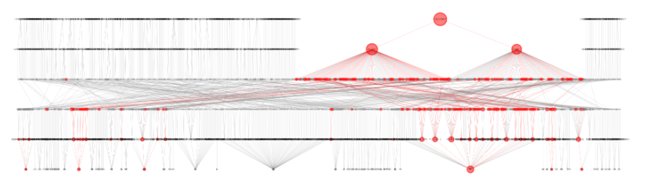
Network Model Toy Visualization
BID
BIN
PAN
ATM
CITY
COUNTRY
Node size = risk value
Countries with high risk value still have many non-fraud transactions
Want to stop fraud based on a combination of levels to reduce false postives

Slide 45
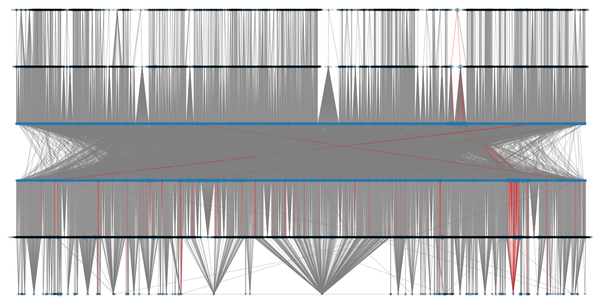
Network Model Visualization – 1 hour Catastrophic Event
BID
BIN
PAN
ATM
CITY
COUNTRY

Slide 46
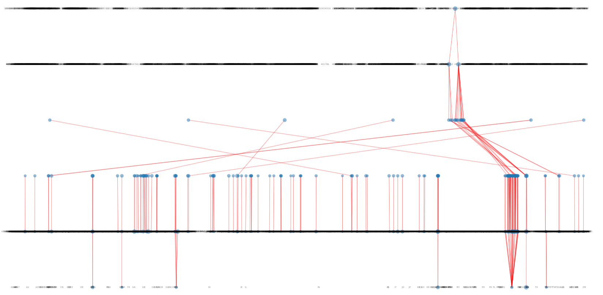
Network Model Visualization – 1 hour Catastrophic Event
BID
BIN
PAN
ATM
CITY
COUNTRY

Slide 47
Agenda
01
02
03
Business Intent & Implementation
EDA & Feature Engineering
DBSCAN
04
05
06
K-means
Network Model
Conclusion & Next Steps

Slide 48
Model Takeaways
Model​ | Advantages​ | Disadvantages ​
DBSCAN​ | Cashout clusters have as high as 95% cashout transactions ​ | Performs poorly when there are very few cashout transactions in a particular hour irrespective of the type of the cashout event
K-means​ | Cashout clusters have 90% cashout transactions Can detect all types of cashout events Quick to execut​e | Kmeans uses pre-trained centroids to assign cluster to new transactions, so it will struggle to detect entirely new patterns of fraud
Networkx​ | Effective at reducing false positives from Visa's supervised model Can create real-time visualizations of Visa's network as cashout events unfold | Cannot properly identify Bid attacks in small cashout events Not considerably more accurate at identifying fraudulent transactions than Visa's current model during disastrous cashout events

Slide 49
Next Steps
DBSCAN
Further tune parameters and adjust inputs to create more predictive power for disastrous cashout events
Kmeans
Fix mislabelled/misreported cities in the data to allow Kmeans to reach its fullest potential
NetworkX:
Create more robust baseline to further decrease false positive rate and allow for combinations of node-levels to be analyzed

Slide 50
Any Questions?

Slide 51
Appendix

Slide 52
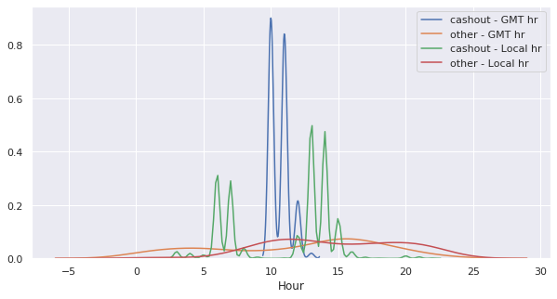
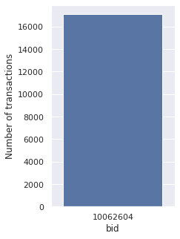


Cashout Events: An example
Time
BID and BINs
Location: countries
17072 transactions
34 countries
1 BID and 4 BINs are attacked
10:00 – 12:00 GMT
5:00 – 7:00, 12:00 – 15:00 Local Time

Slide 53


Cashout Events: An example
ATMs
Accounts
Patterns
Thousands of ATMs and accounts were used
One account and ATM can be used many times
~50% accounts and ~20% ATMs were only used once

Slide 54

Cashout Events: All

Slide 55


K-Means Clustering: Cashout Clusters
01/12/2019
0:00 – 1:00
Ratio = count/1hr_baseline
Cashout Countries:
['BR' 'BG' 'HN' 'AR']

Slide 56






K-Means Clustering: Choosing Threshold
Test range:
 | Cluster 3 | Cluster 5 | Cluster 6
BIN | [3,5,10,20] | [3,4,6,8] | [5,7,10,20]
CITY | - | [1,2] | -
COUNTRY | - | [0.1,0.2] | -

Slide 57

K-Means Clustering: Block BINs
1
Cluster 3
2
1 - 3: camouflaged cashouts
4 - 5: disastrous cashouts
7 - 9: small cashouts
3
4
5
6
Cluster 3 can capture all kinds of cashouts
Cluster 3 is unique in that it can capture small cashouts
Cluster 3 performs worse than Cluster 5 & 6 in capturing camouflaged and disastrous cashouts(lower TP, see next slide)
7
8
9

Slide 58


Cluster 5
Cluster 6
Indicates cashout events
captured by cluster 3
Cluster 5 & 6 are similar: they capture same cashout events

Slide 59

K-Means Clustering: Block BINs & Cities
Cluster 5
Block BINs in cities results in decrease in TP, but increase in FN

Slide 60

K-Means Clustering: Block BINs in Countries
Cluster 5
Block BINs in countries results in decrease in TP, but increase in FN

Slide 61

K-Means Clustering: “FP” may not be FP

Slide 62


K-Means Clustering: “FP” may not be FP

